Slide 1
Decentralized Clinical Trials
Set the frame
30 May 2022
Dr. Simon Rotzler
Bayer (Schweiz) AG, Country Head Site Management
Chair of Interpharma Clinical Research Working Group in Switzerland
MA-OTH-CH-0053-1

Slide 2
Topics Covered
Terminology Clarifications and Definitions
The Basic Concept of DCT
Main Elements
Advantages for Patients, Investigators, Sponsors

Slide 4
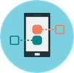
Clinical Trial conduct is heavily regulated, but can be burdensome
Traditional approach – ‘Site Centric’
The impact
19% | of clinical trials are terminated with only 89% of planned patients¹⁾
89% | of RCTs reach recruitment targets in time²⁾
56% | is the average retention rate of patients in RCTs²⁾
Patient
Screening
Rand.
V1
V…
EOT
Investigator
Study procedures,
Lab, MRI etc.
Study Databases
ePRO
Drug dispensing
1) Carlisle B et al. Unsuccessful Trial Accrual and Human Subjects Protections: An Empirical Analysis of Recently Closed Trials, Clin Trials. 2015 February ; 12(1): 77–83 2) Walters SJ, Bonacho dos Anjos Henriques-Cadby I, Bortolami O, et al. Recruitment and retention of participants in randomised controlled trials: a review of trials funded and published by the United Kingdom Health Technology Assessment Programme. BMJ Open 2017

Slide 5
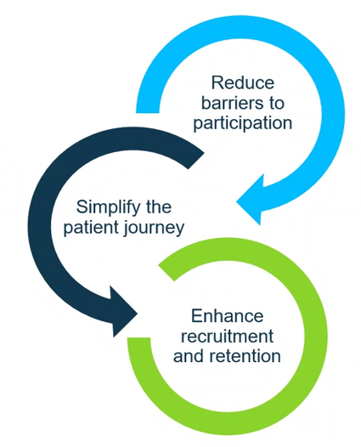
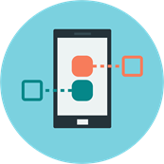
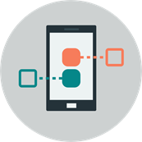
DCTs create greater user centricity and reduce burden by bringing trials to patients …
DCT approach – ‘Patient Centric’
Investigator/metasite
Bayer Databases
Home Visit
Patient
DCT Platform
Home delivery to the patient
Data sources
Direct to Patient
Wearables, Telehealth, ePRO, eConsente
Notes:
DCT opens up possibilities for improved trial designs, including data collection at optimal time points vs. bundling of procedures at some few on-site visits.

Slide 6
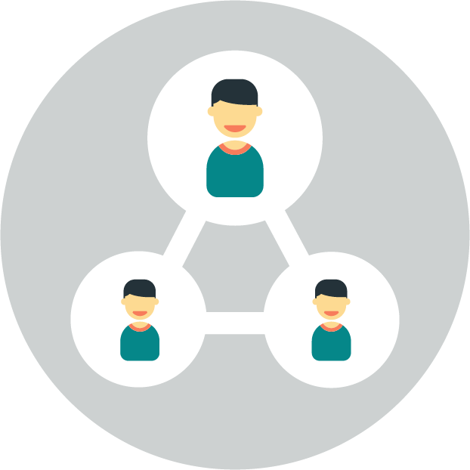
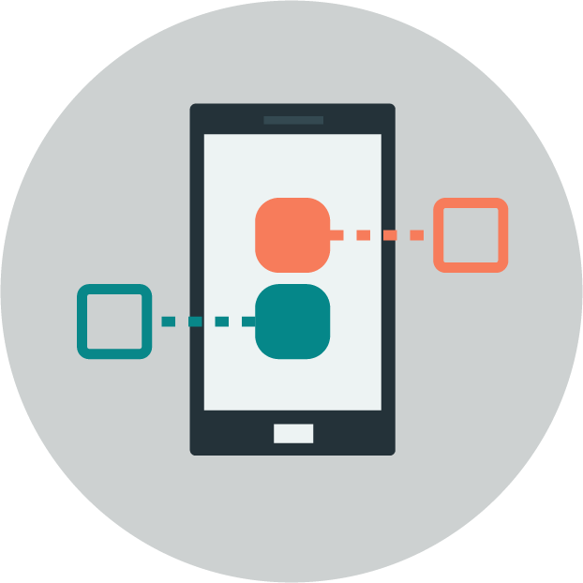
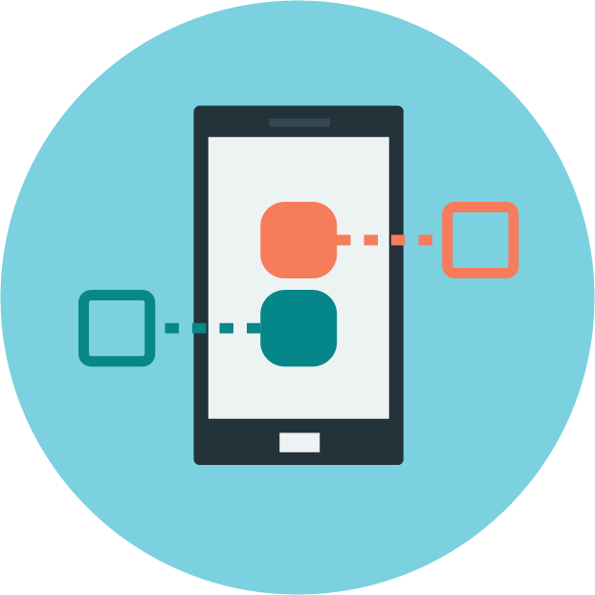
There is a spectrum of Decentralized Clinical Trial types
Traditional trial
May have up to one or two remote components: ePRO, eICF
Basic hybrid trial Collect study data in between on-site visits with separate DCT components
Advanced hybrid trial Some on-site visits replaced with remote visits, plus other DCT components
Full DCT All visits completed remotely plus, other DCT components
On-site Visit
On-site Visit
On-site Visit
Remote Visit
On-site Visit
On-site Visit
Remote Visit
Remote Visit
On-site Visit
On-site Visit
On-site Visit
Remote Visit
On-site Visit
On-site Visit
Remote Visit
Remote Visit
On-site Visit
On-site Visit
On-site Visit
Remote Visit

Slide 7
DCT components to configure more flexible, patient centric study designs
Anything new here?
Not very much, Telemedicine and ePRO is known since the 90-ies already….

Slide 8
Potential Benefits
Of DCT trials

Slide 9
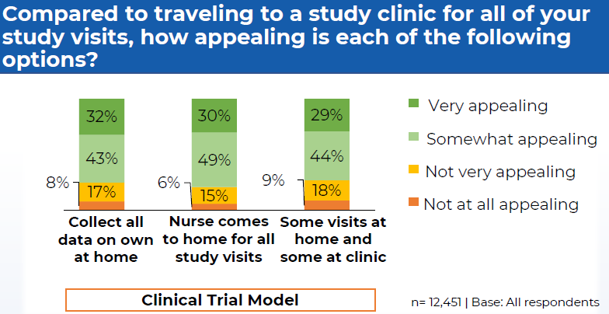
Decentralized Clinical Trials (DCT) are a patient-centric approach to make it more feasible for patients to participate in clinical research remotely (at the patients' location of choice e.g. home, office, vacation)
*Perceptions and Insights Study 2019 – Engagement Preference @ CISCRP
The Center for Information and Study on Clinical Research Participation (CISCRP) is a first-of-its-kind nonprofit organization dedicated to educating and informing the public, patients, medical/research communities, the media, and policy makers about clinical research and the role each party plays in the process. www.ciscrp.org

Slide 10
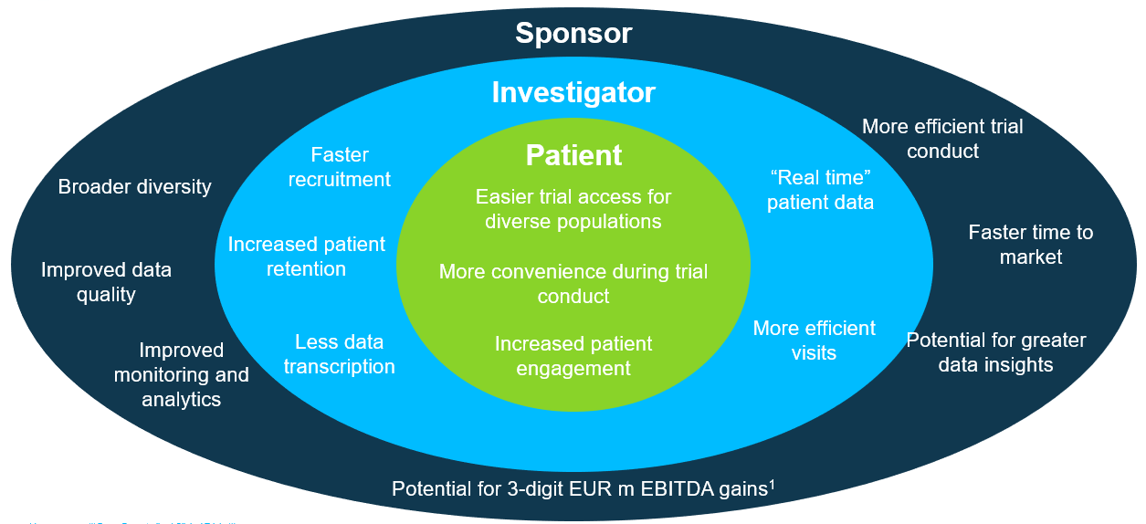
… creating many potential benefits to the entire clinical trial ecosystem
Investigator
More efficient trial conduct
aster recruitment
Patient
“Real time” patient data
Easier trial access for diverse populations
Increased patient retention
Faster time to market
More convenience during trial conduct
More efficient visits
Potential for greater data insights
Improved monitoring and analytics
Less data transcription
Increased patient engagement
Potential for 3-digit EUR m EBITDA gains¹

Slide 11
Take-home messages for DCT in general
DCT will start as a gradual modernisation of trial conduct to make them more user-centric to improve participation, retention, speed and ultimately bring innovative new treatments to patients faster
DCT is not a “big bang” radical change and will not completely alter trial conduct overnight: it rather complements and augments existing processes
Acceptability of DCT approaches is evolving globally and informs our overall strategy – not all aspects or countries are moving at the same speed!
DCT components should only be included into study designs where they add value for stakeholders

Slide 12
Forward-Looking Statements
This presentation may contain forward-looking statements based on current assumptions and forecasts made by Bayer management.
Various known and unknown risks, uncertainties and other factors could lead to material differences between the actual future results, financial situation, development or performance of the company and the estimates given here. These factors include those discussed in Bayer’s public reports which are available on the Bayer website at http://www.bayer.com/.
The company assumes no liability whatsoever to update these forward-looking statements or to conform them to future events or developments.

Slide 13
Thank you!
Bye-Bye

